Slide 1
CHALLENGES FOR GENERAL RAIL FREIGHT
WHAT CAN BE DONE TO IMPROVE THE RAIL SHARE OF A SUBSTANTIAL AND GROWING REGIONAL FREIGHT TASK?
The Rail Freight Alliance Conference, held on 20th September 2019 at the Grand Hyatt, Collins St, Melbourne, had a number of presentations to do with “The Future of Rail in Victoria”. This slide show was one such presentation. All presentations from the conference can be seen on the RFA web site at railfreightalliance.com
Max Michell, Rail Futures Committee Member, produced and delivered this presentation as a follow up to an earlier Op-Ed in the RFI NewsPost April 2019 edition.
Max Michell / Analyst, Advocate, Commentator

Slide 2
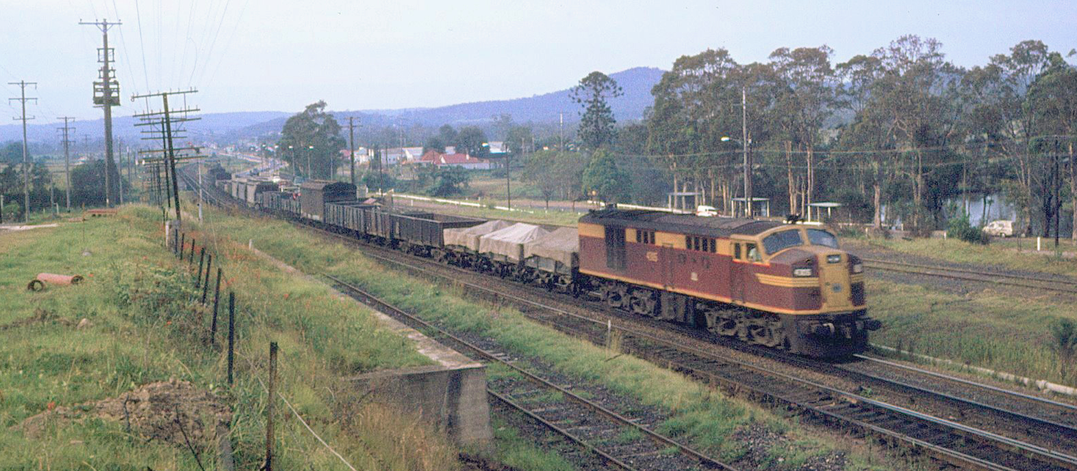
GENERAL FREIGHT ON RAIL – AS IT USED TO BE
Max Michell / Analyst, Advocate, Commentator

Slide 3
GENERAL RAIL FREIGHT RECENT HISTORY: INTER AND INTRASTATE
 | 2008/09 | 2010/11 | 2012/13 | 2014/15
Rail: Syd-Bne | 100 | 95.3 | 92.0 | 106.2
Rail: Syd-Mel | 100 | 97.8 | 91.9 | 91.5
All Land Freight | 100 | 106.1 | 112.6 | 119.4
Vic intra-state by rail (non bulk) | 0 | ---------→ | ---------→ | 0
PoM exports share by rail | 8-11% | ---------→ | ---------→ | 8-11%
Grain share by rail (export) | 60-70% | ---------→ | ---------→ | 50%
Max Michell / Analyst, Advocate, Commentator

Slide 4
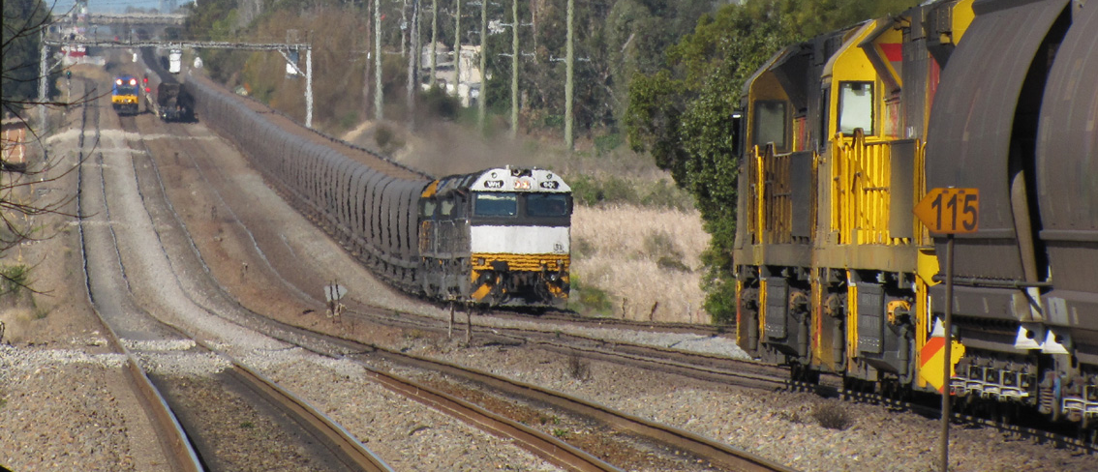
COAL TRAINS EVERYWHERE, BUT WHERE IS THE GENERAL FREIGHT?
Max Michell / Analyst, Advocate, Commentator

Slide 5
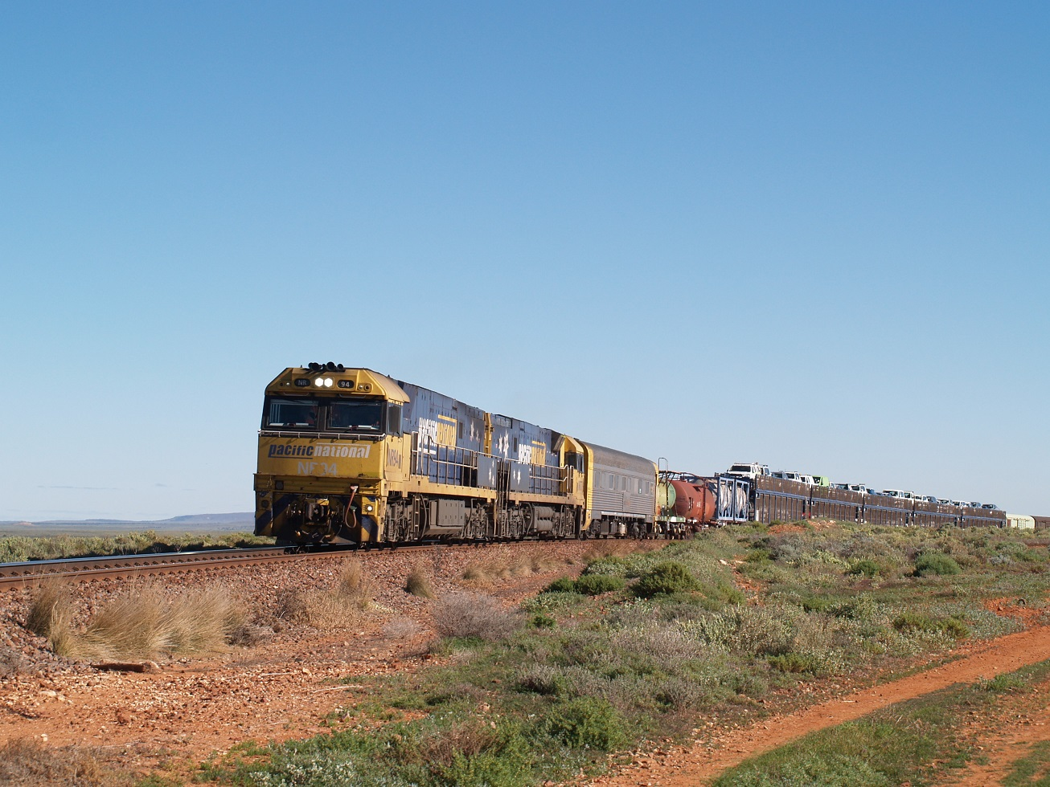
MODERN GENERAL FREIGHT – LIMITED VARIETY AND MAINLY INTER-MODAL
Max Michell / Analyst, Advocate, Commentator

Slide 6
GENERAL RAIL FREIGHT WHAT ARE WE TALKING ABOUT?
General (retail) freight is primarily domestic consumables and durables, the volume of which is closely correlated to population –
Foodstuffs and other domestic consumables,
Durables and
Fuels
Other freight that is largely driven by domestic (retail) demand
Max Michell / Analyst, Advocate, Commentator

Slide 7
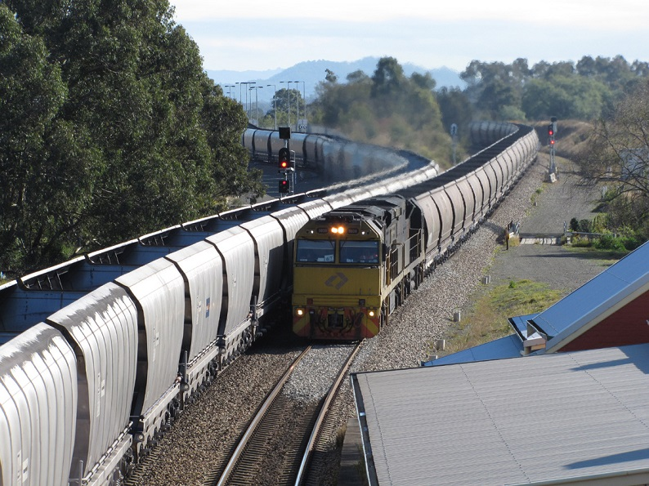
COAL TRAINS RUNNING AT THE SAME FREQUENCY AS SUBURBAN TRAINS
General freight is usually regarded as a distraction in the big (coal and ore) game
In that case do we have the right industry structure?
Max Michell / Analyst, Advocate, Commentator

Slide 8
THE VICTORIAN RAIL SCENE
Victoria has a mix of regional passenger and freight lines as well as interstate trunk lines
At one stage the interstate lines were differentiated by gauge, but now a significant part of the Victorian freight network is standard gauge (Victoria started as an all broad gauge state),
All passenger trains except Albury trains remain on broad gauge.
Victoria now has virtually all the breaks of gauge within its borders (Brisbane and Perth each have just one break of gauge) which leaves this state with a problem that was once national. Prior to 1962 Victoria was a one gauge state (broad gauge).
Max Michell / Analyst, Advocate, Commentator

Slide 9
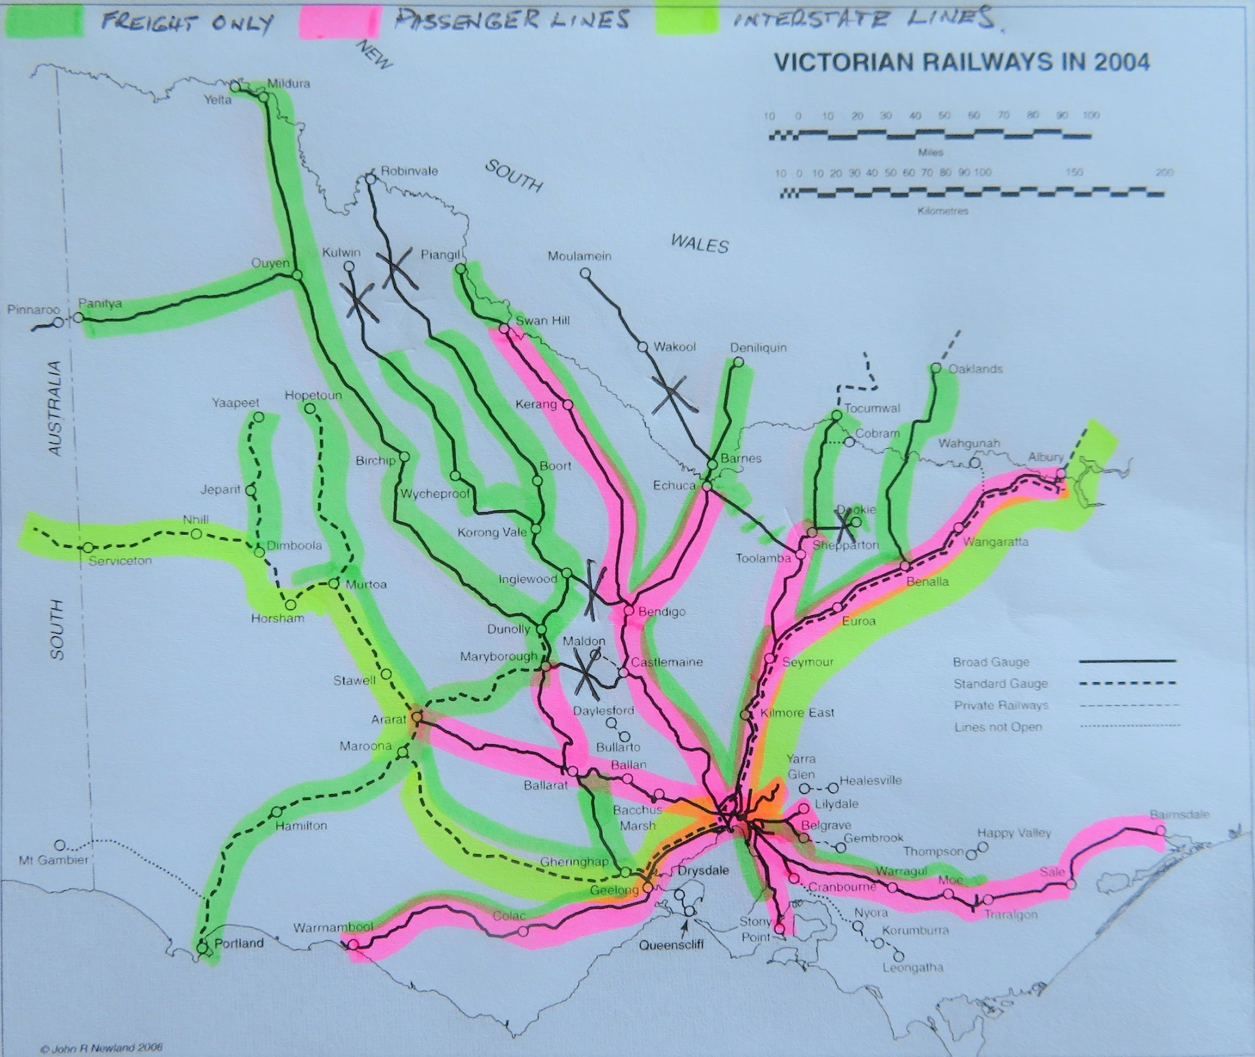
THE VICTORIAN RAIL NETWORK
The rail network currently comprises a mix of
passenger,
freight and
interstate (passenger and freight) and
service suspended lines
spread over two gauges
three track managers
at least eight above rail operators
Max Michell / Analyst, Advocate, Commentator

Slide 10
SCHEDULED VICTORIAN FREIGHT TRAINS
Scheduled freight services are primarily related to agri-export traffic in containers.
Stone traffic runs for Kilmore East to Melbourne
Paper products run from Maryvale to Melbourne (export and interstate)
Steel coil runs to Long Island (Hastings) from Pt Kembla.
Cement runs Melbourne to Lyndhurst (will become Geelong to Lyndhurst)
Future freight traffic: Benalla to Melbourne (concrete structural segments) and Ultima (hay)
Max Michell / Analyst, Advocate, Commentator

Slide 11
THE VICTORIAN FREIGHT PICTURE
The Victorian Freight network has a number of lines with scheduled freight trains –
Warrnambool (5/week)
Dooen (Horsham) (up to 7/week, but well down due to drought)
Mildura (5/week, recently increased from 3/week)
Deniliquin (3/week but reduced during drought)
Tocumwal (3/week but reduced during drought)
Maryvale (Morwell) (7/week – paper for export and domestic)
Kilmore East (10/week – stone for construction industry)
Long Island (circa 14/week - steel coil transhipped from Pt Kembla)
Lyndhurst (5/week – cement in containers)
Prospective – export hay ex Ultima, concrete structural segments ex Benalla
Max Michell / Analyst, Advocate, Commentator

Slide 12
“GRAIN ONLY” LINES
A number of freight lines are nominally “grain only”.
Most have ‘on demand’ train running, highly dependent on seasonal conditions.
Deniliquin has scheduled services (rice) for export in containers as well as bulk grain.
Echuca – Toolamba is ‘closed’ due to track deterioration (but important for future standard gauge strategy).
Dookie is closed but is talked of as potentially being revived for grain
Other lines are bulk grain only
Max Michell / Analyst, Advocate, Commentator

Slide 13
UNSCHEDULED FREIGHT LINES
The part of the Victorian Freight Network that does not have scheduled freight services is largely “grain only” status –
Many of these lines are virtually disused while the drought persists.
Some of these lines are in a ‘managed decline’ condition which means either lines remain barely operable or actually become inoperable
Management of freight track by the Passenger Operator (V/Line) is a major factor for freight line condition and freight train operation.
Max Michell / Analyst, Advocate, Commentator

Slide 14
GRAIN FREIGHT
Victorian grain freight is a major part of the overall rail freight task.
Rail used to have up to 70% of the export grain market.
Then came deregulation of the grain market
along with a privatised rail freight industry
the Victorian grain task spread over two gauges, changing the balance of efficiency and haulage costs
and track management by a passenger rail operator
The reaction was –
‘take or pay’ grain haulage contracts by risk averse rail operators.
degradation of freight rail track by largely disinterested rail track manager
The outcome was
transfer of significant grain volumes to road
reduction of rail capacity – low train speeds and few passing loops
broad gauge grain system slowly being gauge converted, progressively isolating residual parts of the grain haul with regressive service and cost outcomes.
Max Michell / Analyst, Advocate, Commentator

Slide 15
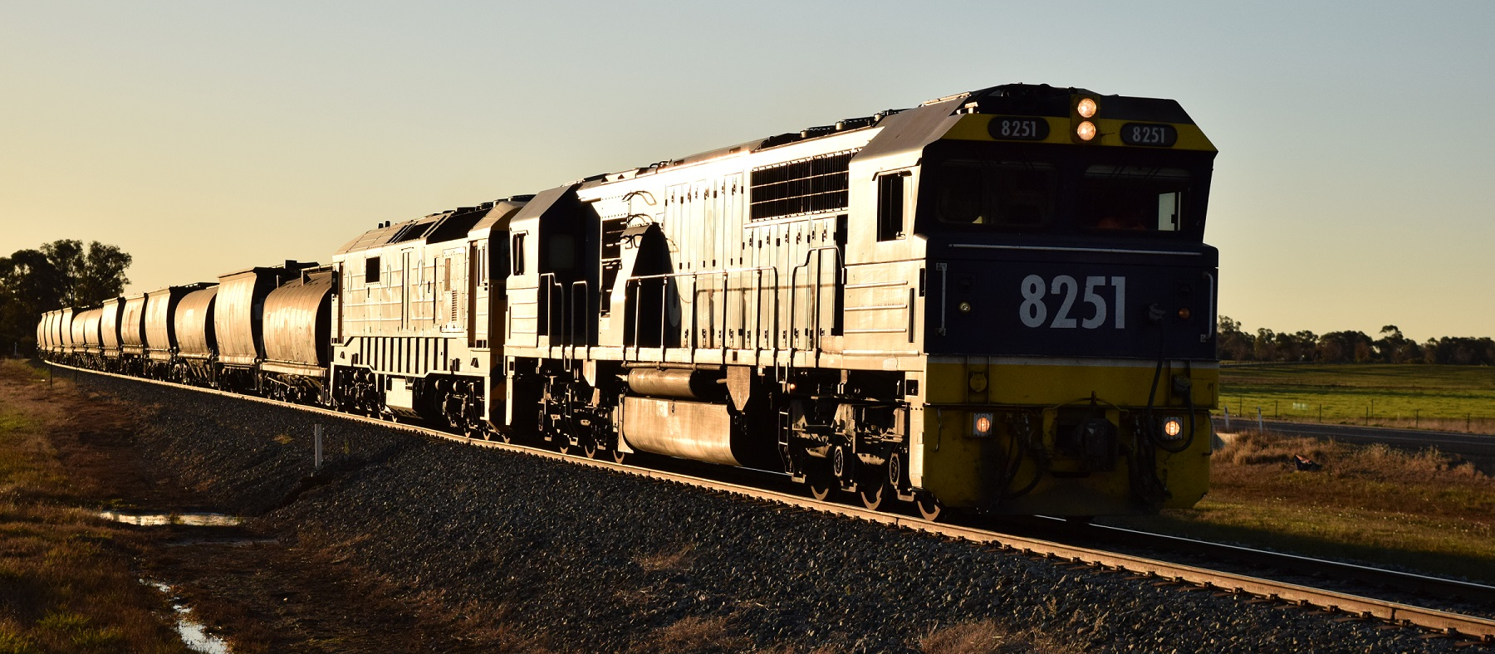
BULK GRAIN – A MAJOR VICTORIAN RAIL TASK
Max Michell / Analyst, Advocate, Commentator

Slide 16
GENERAL RAIL FREIGHT WHAT ARE WE TALKING ABOUT?
Victoria has no general freight on rail.
A rough rule of thumb – one tonne of general consumables and durables per head of population.
Victorian regional population circa 1.5 million; living in 670,000 dwellings; driving 1.4 million motor vehicles.
Discounting for near Melbourne regionals and those in remote areas there could be circa 1.0 to 1.2 million tonnes of general freight p.a. Some of this could be a rail opportunity in the right circumstances.
Max Michell / Analyst, Advocate, Commentator

Slide 17
KEY FACTORS – NO RELATIONSHIP WITH REAL CUSTOMERS
Rail has no relationship with the real general freight customers .
General freight on rail is now almost all cross-border inter-modal handled by third party ‘brokers’ who have no alliance with or allegiance to rail.
‘Broker’ decision making is what is best for them while satisfying their customers needs. In many cases the ‘brokers’ are also large scale trucking operators. Rail doesn’t rate highly.
If rail doesn’t know who the real customer (producer or consumer of the freight) is how can they tailor the service to best meet their customers needs.
If rail is unable to tailor the service product to meet the (real) customers needs then they are unable to ‘own’ or ‘control’ any part of that market.
Max Michell / Analyst, Advocate, Commentator

Slide 18
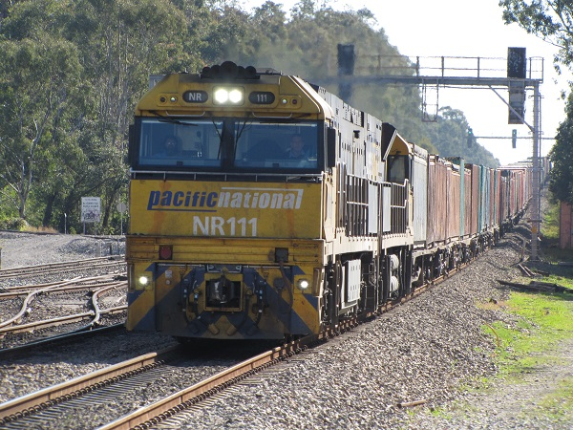
INTER-MODAL FREIGHT: 1500 METRES OF ANONYMITY
We don’t know who the real customer is and most probably the rail operator doesn’t either.
Max Michell / Analyst, Advocate, Commentator

Slide 19
KEY STRATEGIES – SHORT LINES 1
There are a number of ways in which rail can build (real) customer relationships.
A North American solution is Short Lines – small community based, vertically integrated rail operators with multi-skilled employees which become part of the logistics chain of their customers within their community by giving exemplary service.
Short lines are closely allied to local producers and shippers, and manage the gathering and distribution of local freight to/from their area.
Short Lines are the hunter-gatherers of the rail world. They book alliances with ‘wholesale’ railway operators for the line haul part of the freight task.
Max Michell / Analyst, Advocate, Commentator

Slide 20
KEY STRATEGIES – SHORT LINES 2
Short lines in this country would have to contend with
the fragmented railway industry,
‘main line’ regulation that allows no concession for smaller type operations, and
a change in competition policy (for which there are precedents) One small operator has established a naturalised version of a short line, that largely gathers regional freight by road (in the absence of a suitable operational rail network) and aggregates the traffic into blocks of rail traffic for attachment to pre arranged passing trains.
Max Michell / Analyst, Advocate, Commentator

Slide 21
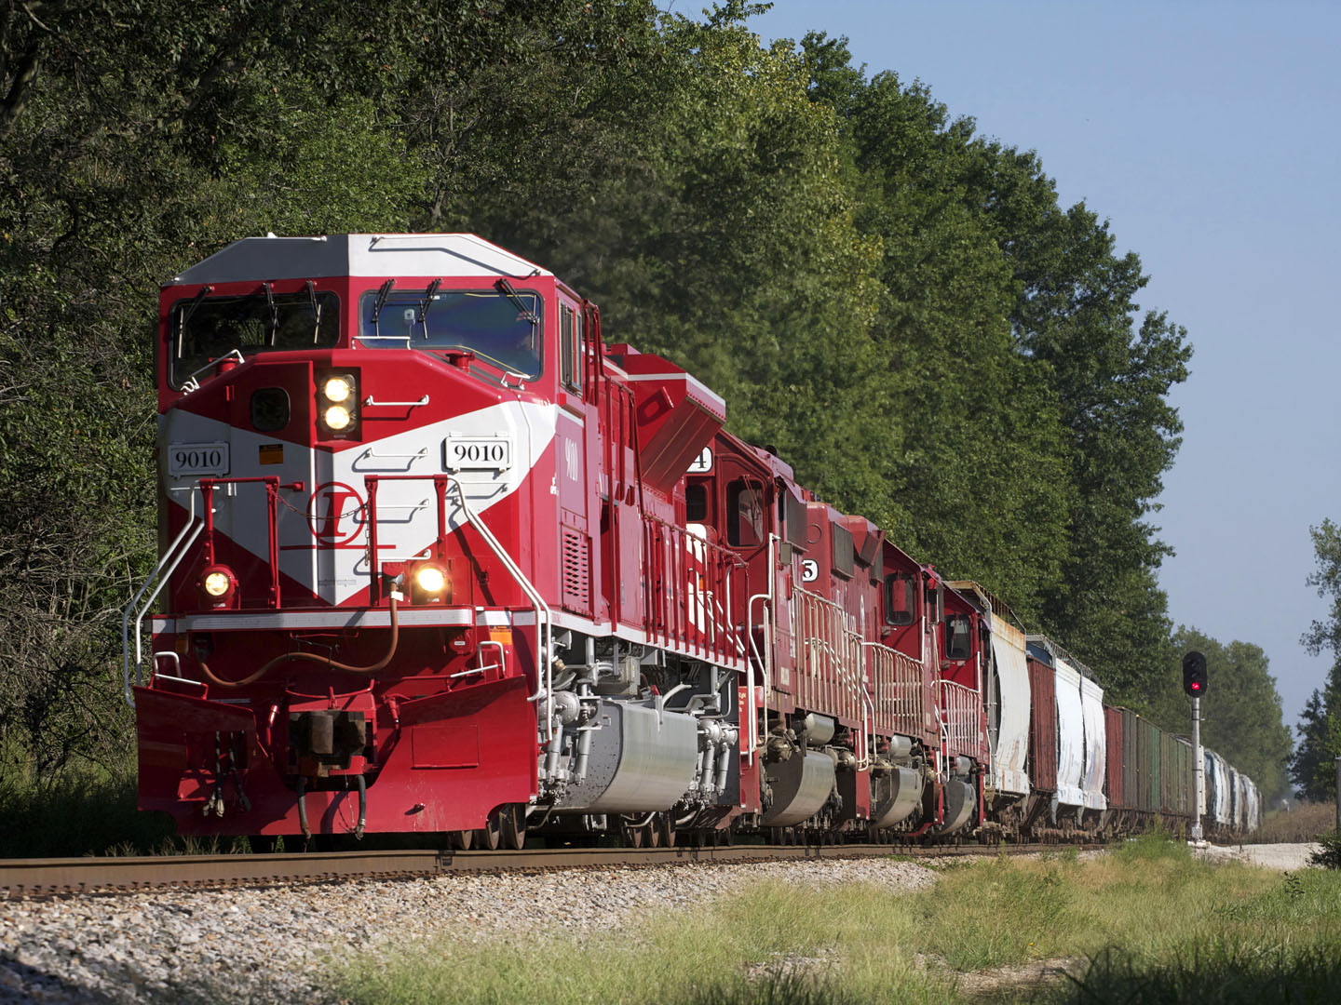
SHORT LINE – CASE STUDY 1
Case Study – Indiana Rail Road
Regional Indiana Rail Road created in 1986 – mainly coal hauler.
Loss of key business in 2015 = potential disaster
Employee-lead survival plan based on core rail operating skills and knowledge of existing and potential users
Since 2015 IRR has diversified beyond coal to a vastly expanded customer base = survival for the company
Max Michell / Analyst, Advocate, Commentator

Slide 22
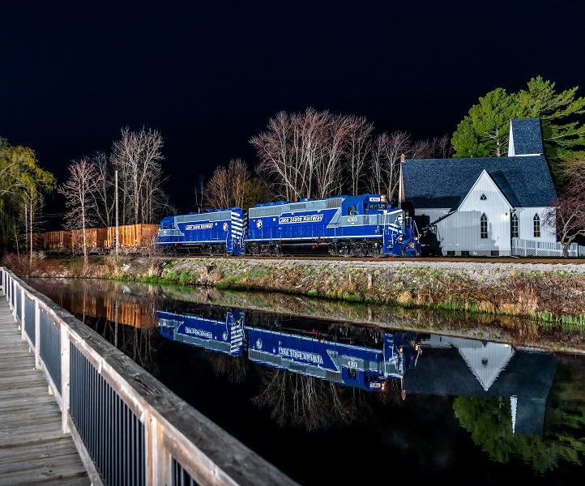
SHORT LINE – CASE STUDY 2
Lake State Railway
US Short Line founded in 1992
In 2013 traffic dropped 27% to an average 10 car loads a day = imminent closure
New strategic growth (recovery) plan in late 2013, with 5 year capital plan, based on:
Re-energised customer relationships
Additional services for existing users
Attract new customers with transload service and investment in new equipment
Viable traffic volumes by 2017
On course to double by 2020
Max Michell / Analyst, Advocate, Commentator

Slide 23
KEY STRATEGIES – PRIVATE SIDINGS
At one time Victoria had hundreds of private sidings, ranging from leased sites in the local station yard to a stand alone siding(s) into the customers premises (sometimes quite remote from towns or stations).
Around 40 years ago the concept of private sidings (and of wagon load traffic) came to be regarded as a cost burden – the result being that very few private sidings now exist other than those for train load traffic.
Private sidings provide a direct link with customers and have the advantage of removing the significant ‘last mile’ barrier to service that applies from common user terminals.
However private sidings need to be well located, have a reasonable traffic volume and be able to be served by rail with a high level of reliability while being cost effective.
Max Michell / Analyst, Advocate, Commentator

Slide 24
KEY STRATEGIES – LOGISTICS ESTATES
Co-location of Logistics Facilities (warehouses / freight receival / delivery facilities / cross docking capabilities etc.) inside or adjacent to rail freight terminals largely removes one of the major obstacles to freight on rail – that of the ‘last mile’ between the terminal and customer. Logistics Facilities are a value adding service enhancer.
The logistics facility allows the collection, storage and delivery of freight, including sorting and re-consigning freight (in an appropriate mix) to the end receiver, and notably all by one logistics operator.
So for instance canned freight received in the Logistics Facility from a Tomato Canner might be despatched as part of a mixed consignment to order for a Supermarket.
If the Rail Operator and Logistics Facility are under common ownership then the customer relationship is very tight (e.g. SCT) – if the logistics facility and rail operator have different ownership the physical proximity of the two goes some way toward creating good customer alliances.
Max Michell / Analyst, Advocate, Commentator

Slide 25
AN INTERESTING AUSTRALIAN EXAMPLE
BALCO is the South Australian Balaklava Cooperative located around 100 km north of Adelaide. It is the only intrastate rail freight operator in SA (other than for bulk grain).
BALCO’s business is in processed stockfeed for export. For transport it set up a simple rail terminal at Bowmans on the Adelaide - Port Augusta main line, and started running their own train to Port of Adelaide.
Traffic grew to reasonable volumes allowing a quite sizable train for a relatively short haul.
Expanded to pick up lead for export from Port Pirie – an extension of their existing train.
Next picked up mineral sands traffic from Broken Hill – separate train but sometimes ‘double stack’ empty containers Adelaide to Bowmans to improve container turn round.
Subsequently got imported solar farm components on rail to Port Augusta for installation. Most recently has been moving export timber traffic through a new terminal (siding) at Bordertown 300 km south east of Adelaide.
Max Michell / Analyst, Advocate, Commentator

Slide 26
KEY FACTORS - TERMINAL EFFICIENCY
Inter-modal terminals interface between trains with >= 200 TEU and trucks with 2 TEU.
Rail measures its performance terminal to terminal. Customers (which rail does not have any relationship with) measure door to door.
‘Last mile’ of door to door is not under control of rail – rail has no knowledge of customer perception of performance and no ability to control that performance. Cost of ‘last mile’ haul is disproportionately high – can cripple rail on pricing despite rail’s line haul cost advantage.
Current large scale terminals are inefficient for rail (terminals tranship direct between trucks and trains lowering rolling stock utilisation) and for trucks (waiting in queues, waiting for lifting machinery to get to position for random container selection).
Major issue is that terminals are NOT the real customer – real customers are somewhere down the line out of the purview of rail.
Max Michell / Analyst, Advocate, Commentator

Slide 27
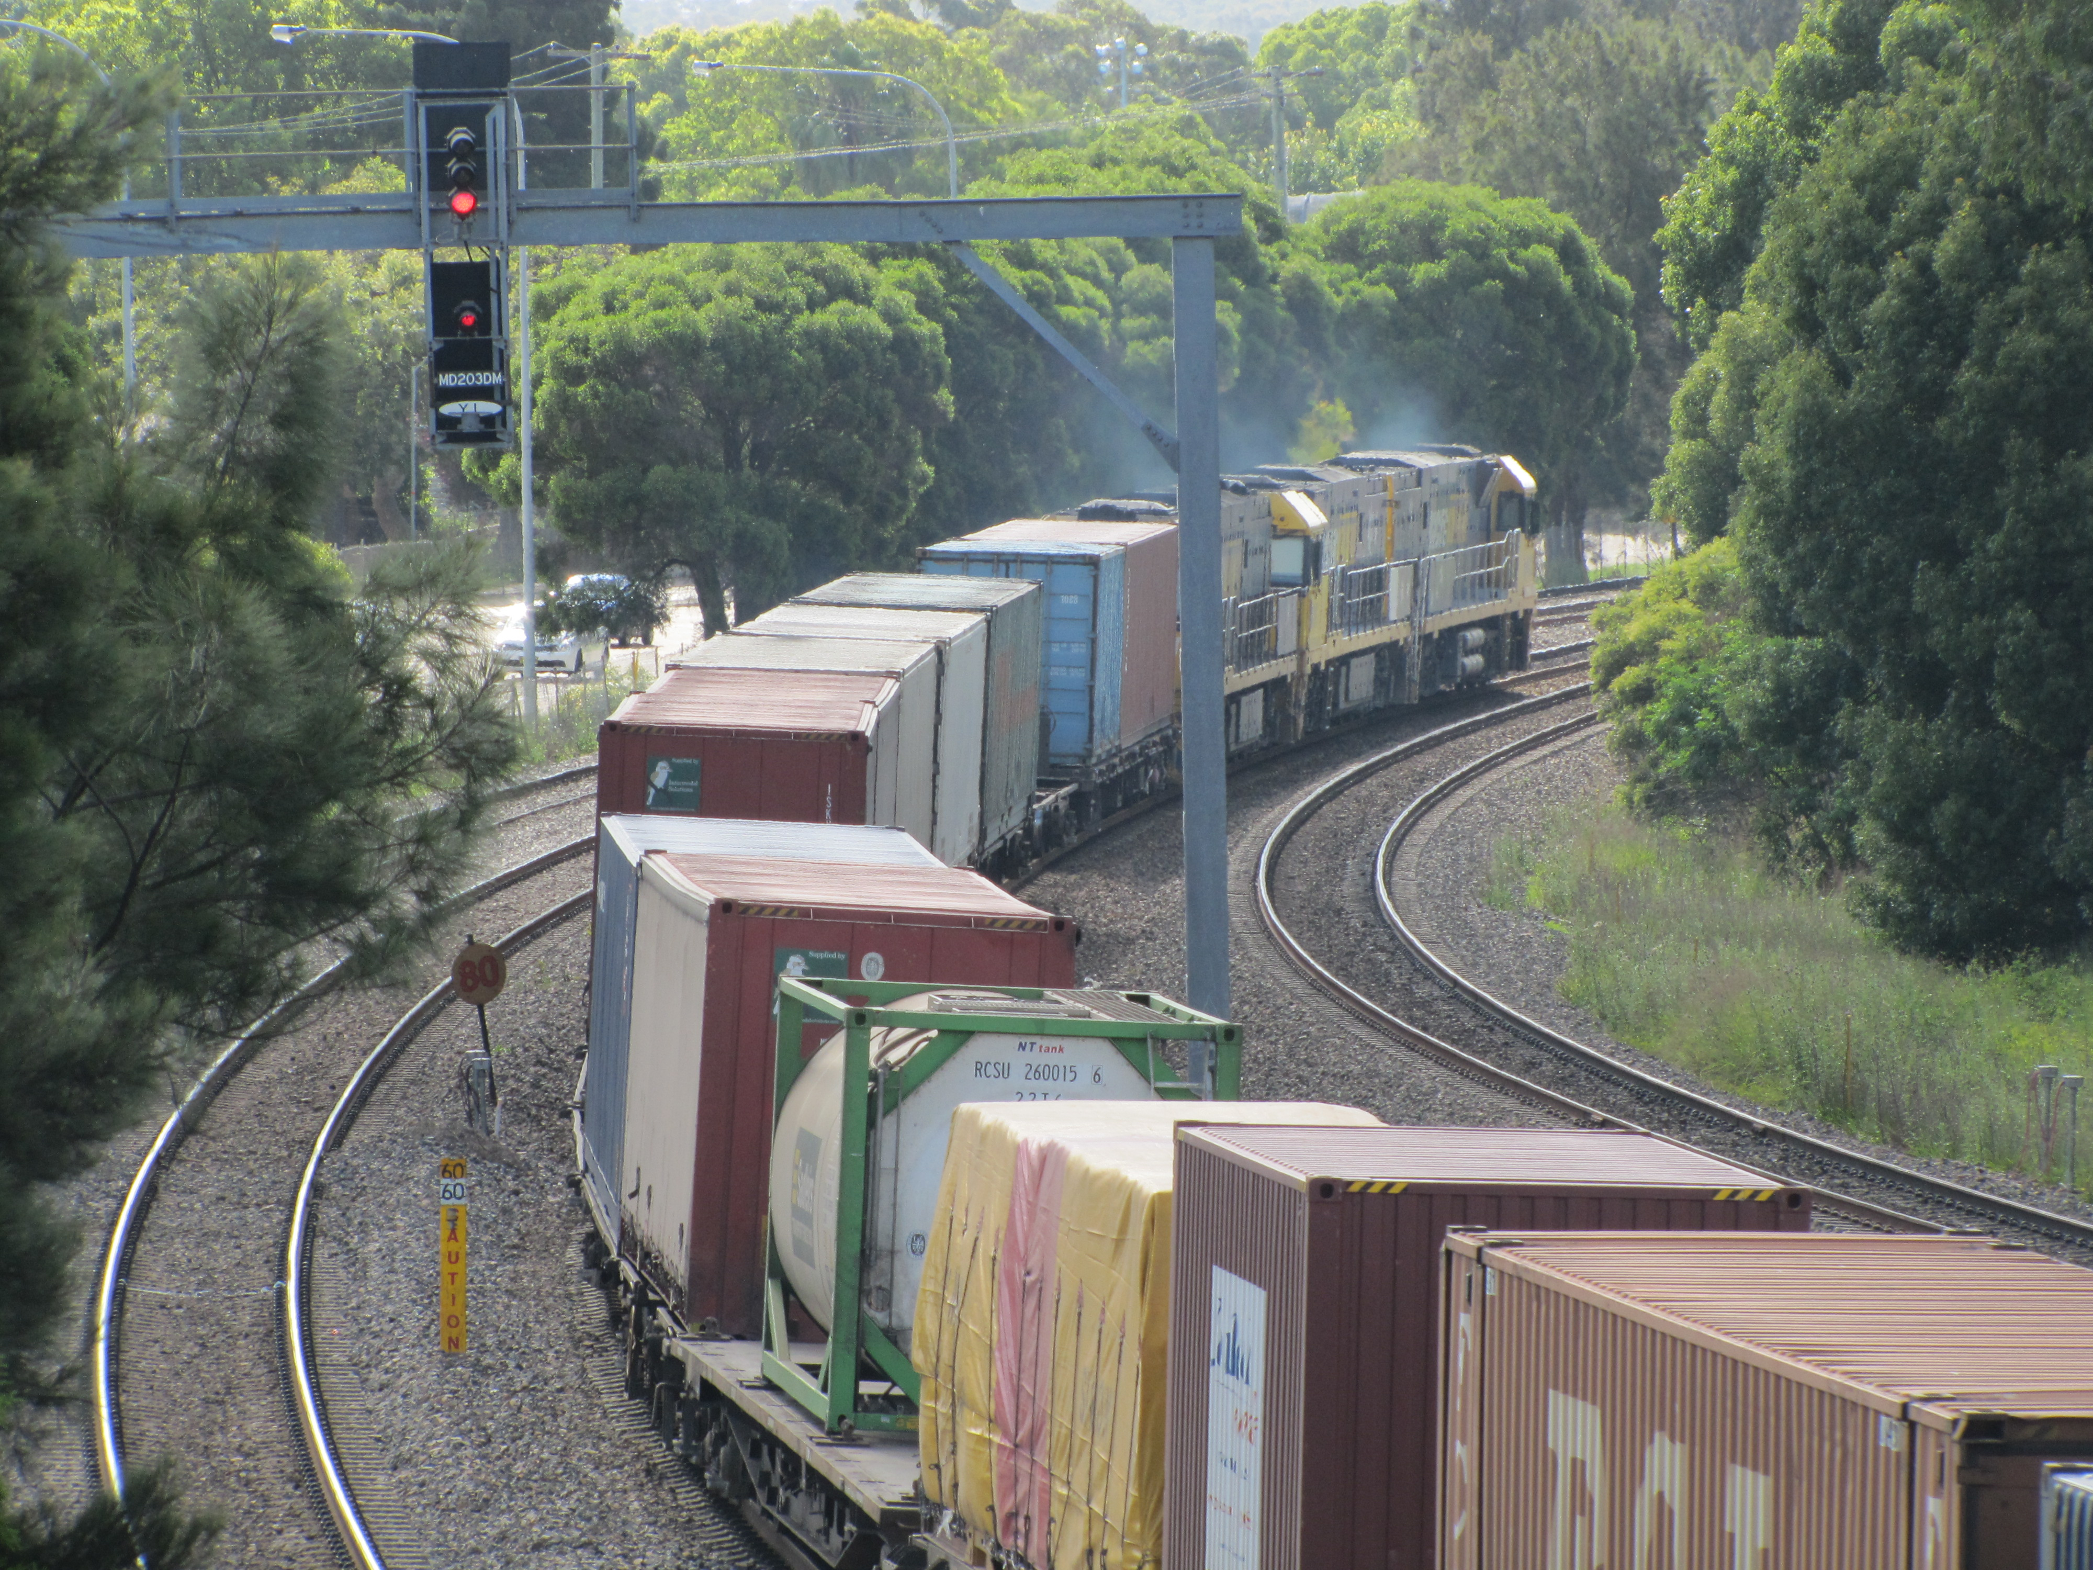
INTER-MODAL FREIGHT: 1500 METRES OF RANDOMNESS
Random containers – what order will the pick up trucks arrive to collect this mixed trainload of containers?
Efficient terminals would separate the train load/unload and the truck load/unload via a data intensive physical buffering system.
Max Michell / Analyst, Advocate, Commentator

Slide 28
KEY STRATEGIES - TERMINALS
The major issue with big terminals as we know them (e.g. South Dynon, Chullora, Acacia Ridge) is that they largely create a barrier between the rail operator (wholesaler) and the real customer. Terminals do not need to be ‘big’ to be fit for purpose.
The relatively efficient line haul on rail is largely overwhelmed by high cost short haul ‘last mile’ activity that is mostly not controlled by the railway. Door to door transport fees are higher than they could be while reliability (as seen by the real customer) is out of the control of the railway.
Many of the strategies mentioned earlier are also relevant to the terminal issue - short lines (a form of ‘last mile’ activity), logistics estates and private sidings (a personal terminal for the customer) have a place.
Rail management of the ‘last mile’ would bring the customer relationship much closer while reducing costs over all. If (when) autonomous trucks become viable then rail has a big opportunity to directly control the ‘last mile’ activity.
Max Michell / Analyst, Advocate, Commentator

Slide 29
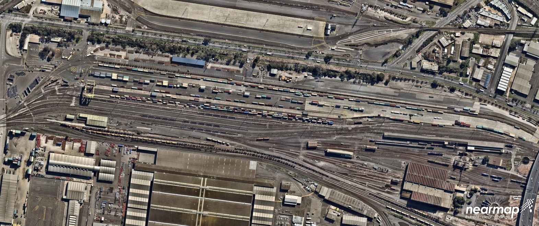
KEY STRATEGIES - TERMINALS
South Dynon Terminal from above. Lots of rail tracks, some roadways and nowhere for a container stack to ‘buffer’ the rail and road loading, or for any ancillaries such as warehousing, or tracks for train arrival and departure separate from the container handling tracks. Very old school!
Max Michell / Analyst, Advocate, Commentator

Slide 30
KEY FACTORS – TRAIN RUNNING
There is effectively no general freight on rail within Victoria. As such lessons to do with train running need to be taken from Interstate inter-modal operations.
Train running needs to have high utilisation of wagons and locomotives - minimise the fleet requirements required for the task
Frequency of services needs to be appropriate to the market and traffic volumes, but sufficient to allow for overall growth and day to day fluctuations. The higher train frequency the better the service quality to individual customers.
To the extent possible train running needs to flatten the work load on terminals – avoid everything arriving and/or departing around the same time.
Where multiple trains are justified each day, use differential pricing to spread the loading over trains on less popular timings;
Faster door to door transit is one result of multiple daily trains.
Where traffic volumes are limited use a single train consist to serve a number of routes
Max Michell / Analyst, Advocate, Commentator

Slide 31
TRAIN RUNNING – CASE STUDY
Current Melbourne – Brisbane inter-capital freight trains –
A total of ten train services each way per week
These trains operated by two different operators
One operator has six train services per week – daily except Sundays
24 or 48 hours between departures
1500 m long trains (circa 200 TEU fully loaded)
Four train consists required – each does 3 single trips/week
If seven trains per week, the same four consists would achieve 3.5 trips /week
If two shorter trains /day each way and fast turn round at each end then –
Each train would achieve four single trips / week
Productivity gain +33% on assets;
Available freight capacity with same trains/more wagons up to around +80%
Max Michell / Analyst, Advocate, Commentator

Slide 32
INFRASTRUCTURE – FIT FOR FREIGHT TRAIN OPERATION
Freight infrastructure is in the hands of
ARTC (interstate network and certain regional lines in Victoria),
V/Line (Passenger operator) which manages all the freight network in Victoria other than that managed by ARTC, and
MTM to the extent that freight needs to use shared line sections with suburban trains
Several major issues are apparent across this freight network
Limited or no infrastructure to facilitate freight train running on passenger lines
Very few sidings left where prospective freight (other than grain and in a few cases containers) can be loaded
Slow and conservative train speeds and axle loads on the freight network
Max Michell / Analyst, Advocate, Commentator

Slide 33
INFRASTRUCTURE – SIDINGS AND LOADING SITES
Traditionally there were public goods sidings at most country (regional) stations and a small number of suburban stations.
The vast majority have been swept away, leaving a reduced number of grain sidings and some quite limited container loading sites and little else.
In many cases there are no facilities other than a passenger platform left.
For instance Ballarat and Bendigo have no usable facilities for freight despite having populations of circa 100,000 each.
Between Melbourne and Sydney there are only 5 places where freight (wagon load or greater) might be able to get loaded - Benalla with difficulty, Ettamogah (Col Rees would welcome you in), Bomen (Wagga North) if there is siding space, Cootamundra (maybe?), and Goulburn (in the old loco depot / workshop site).
Not Good!!
Max Michell / Analyst, Advocate, Commentator

Slide 34
INFRASTRUCTURE – TRAIN RUNNING
Freight train running on passenger lines is limited by frequency of passenger trains. Despite this the Maryvale containers, Lyndhurst cement and Westall stone trains comfortably manage to run between 10 minute frequency suburban trains on the Dandenong line without causing grief.
Freight lines are another issue. These are managed by V/Line which has no real interest in freight. Most are speed limited as a result of a policy of ‘managed decline’ (the policy you have when nothing is done to arrest inevitable decline in condition).
Freight really needs line speeds of 60 km/h or higher in order to achieve any sort of efficiency in its operation.
Freight also needs adequate facilities (such as refuge loops) so that it can be ‘pathed’ as part of mixed traffic (passenger and freight) lines.
Situation has been made worse by inexperienced conservative track management and extremely poor project management.
Max Michell / Analyst, Advocate, Commentator

Slide 35
INFRASTRUCTURE – A PARTICULAR CASE
As part of the extremely badly managed Murray Basin Project (gauge conversion of the Mildura, Murrayville, Sea Lake and Manangatang lines) the 88 km Maryborough – Ararat line was reconstructed with concrete sleepers and a good serve of ballast, but retained its used 80 lb/yd (40 kg/m) rail.
Train speed on the line for all trains over most of its length and some trains for all its length is 40 km/h with 21 tonne axle loading tolerated ‘under sufferance’. How does this stack up against practice elsewhere?
The Tarcoola – Alice Springs (opened in 1980) has 100 km of identical 80 lb/yd rail (already 65 years old) on concrete sleepers which has always been rated at 80 km/h with up to 23 tonne axle loading. 40 years later it is still working with much more traffic now than when it opened.
Beyond Cobar in western NSW a private mine line of around 30 km had light weight 60 lb/yd rail. In order to get ‘heavy’ locos out to the mine without the cost of re-railing, the existing rail was cropped and welded. It works just fine – meeting the need for transport with an asset that is fit for purpose.
Max Michell / Analyst, Advocate, Commentator

Slide 36
RAIL REGULATION
Rail regulation now national – ONRSR
Supposed to be co-regulation, but field application is micro-managed / heavy in detail
Heavy vehicle (road) regulation is light handed and relatively non intrusive.
Rail regulation takes no account of anything outside its own railway remit
Every tonne of freight on road has 14 times more crash costs and damage as the same tonne on rail.
Many other imposts in the way of accreditation etc which hamper the ability of rail to compete on an even playing field.
Combination of rail regulation and accreditation stifles innovation and productivity on rail.
Max Michell / Analyst, Advocate, Commentator

Slide 37
COMPETITION POLICY
Competition policy is intended to manage commercial activity so that ‘consumers’ are not disadvantaged.
A lot of ACCC work is associated with merges or takeovers of significant companies.
In the railway world ACCC has looked at large scale rail corporate activities as being a rail on rail issue – reasonable for major bulk operators (such as in the coal business) but off course when it comes to general freight.
The real competition for general and similar freight is rail on road. Failure to recognise this has skewed the ability of rail to compete in these more competitive markets.
Max Michell / Analyst, Advocate, Commentator

Slide 38
WHAT OPPORTUNITIES MIGHT THERE BE?
Although there is zero general freight on rail in Victoria as it stands, there are opportunities out there, provided rail can ‘bond’ with customers to create a robust logistics chain.
Given the relatively short distances in Victoria there are significant opportunities for short line / boutique operators to take up the challenge here (there clearly is no interest on the part of the incumbent wholesale rail operators
Agri-exports
Stockfeed
Dairy
Wine
Cotton and cotton seed
Tree crops (nuts etc)
Boutique seeds and grains
Processed meat
Logs and timber
Mineral sands
Construction stone and sand
Garbage – landfill or co-generation
Regional manufactures
Regional produce
Regional imports
Fuel
Strategic fuel reserves
Max Michell / Analyst, Advocate, Commentator

Slide 39
WHERE TO FROM HERE (NOWHERE TO GO BUT UP !!)
Rail needs to work toward being part of the simplification of customer supply chains.
Rail need to build far closer alliances and partnerships with customers and shippers ( to reconstruct Harold Clapp’s words “get to know your customers and have them get to know you”).
Rail needs to minimise significant cost and service impediments in the line haul / terminal / customer mix.
Rail needs to maximise the utilisation of its assets.
Max Michell / Analyst, Advocate, Commentator

Slide 40
HOW TO FROM HERE (HOW TO GO UP !!)
These will require
a new mind set and culture inside rail,
recognition that rail on road is the real competition model,
regulatory reform to enable innovative ways of economically capturing new traffic,
A new and more mature relationship between major players in the rail industry (players in an industry not players in their own company) and
strong and focussed leadership with real experience in and empathy for the rail freight business.
Max Michell / Analyst, Advocate, Commentator

Slide 41
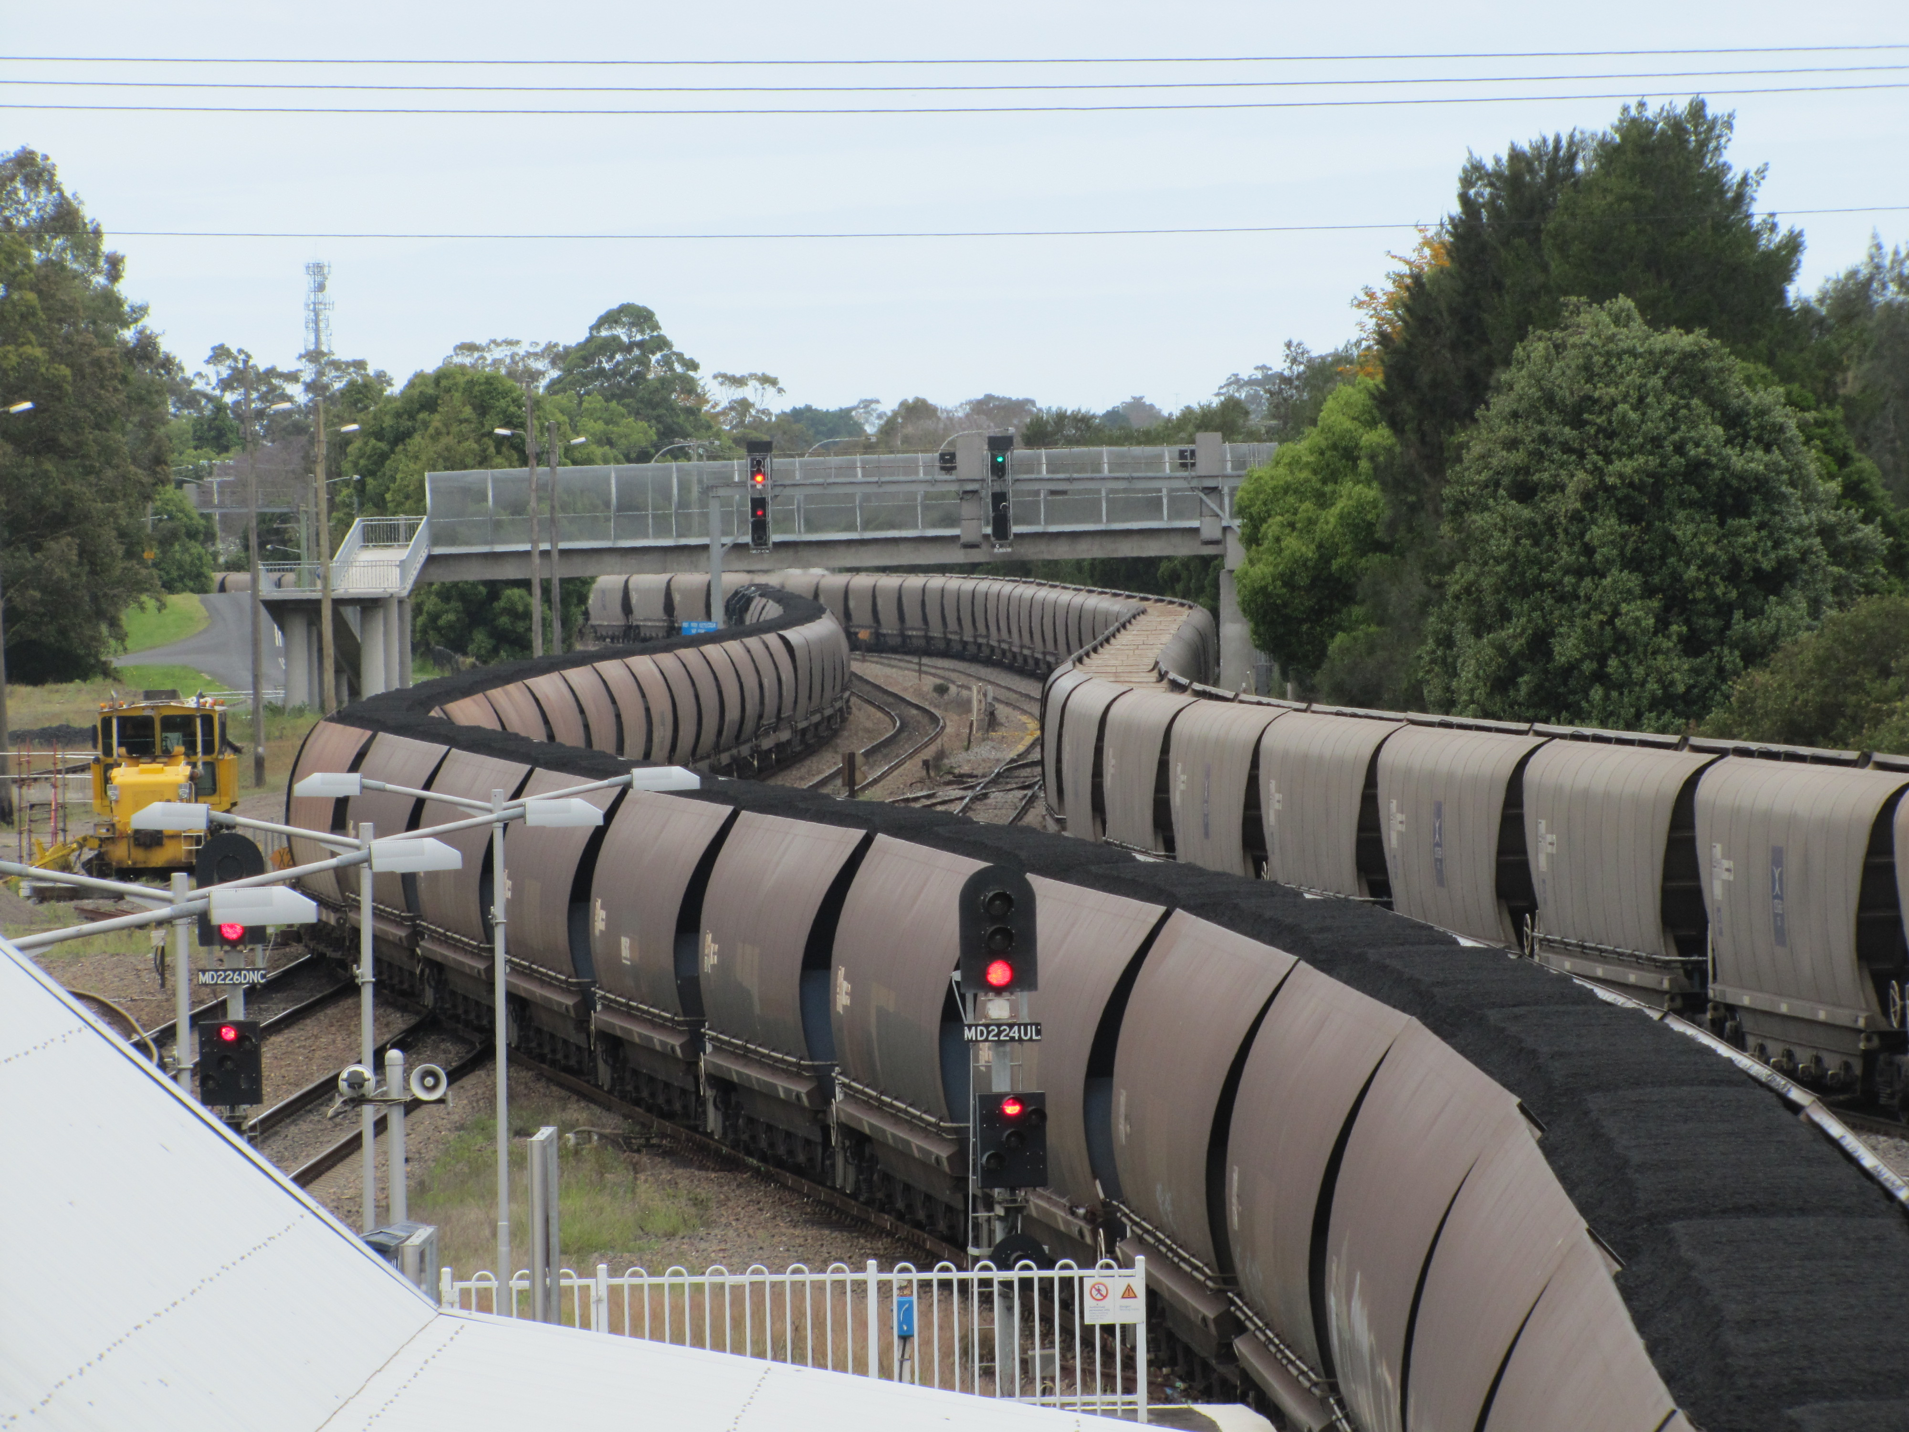
QUESTIONS? (BUT NOT ABOUT COAL !)
Max Michell / Analyst, Advocate, Commentator

