Slide 1

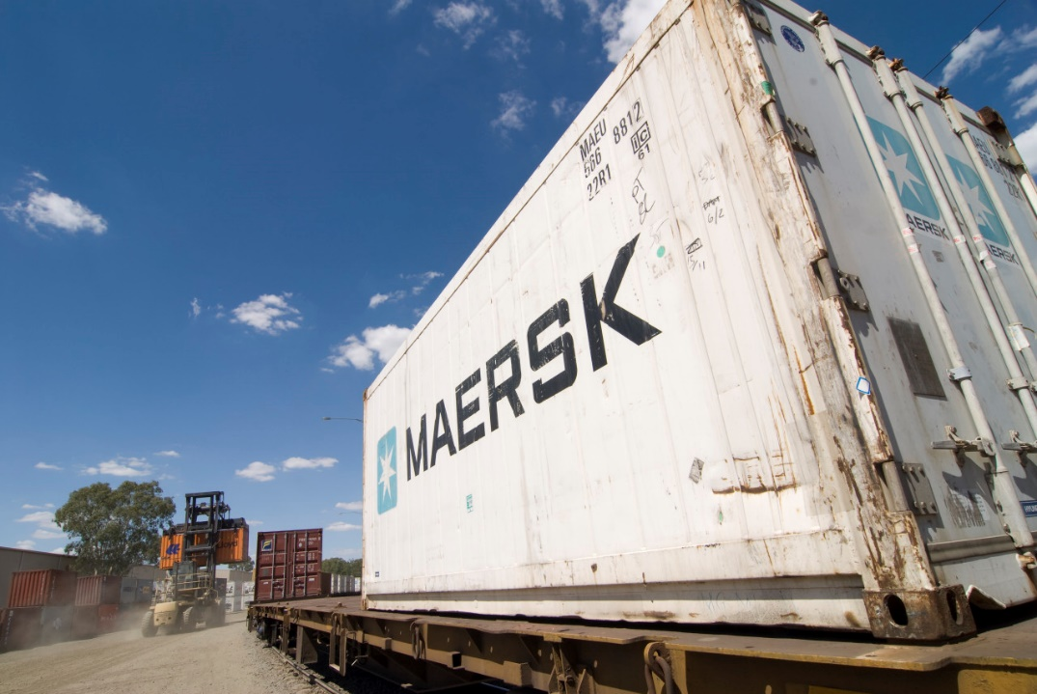
Andrew Newman
Director Freight, Ports and Intermodal
Freight Victoria

Slide 2
A new integrated Department of Transport
MINISTER FOR PUBLIC TRANSPORT
MINISTER FOR PORTS AND FREIGHT
MINISTER FOR
TRANSPORT INFRASTRUCTURE
MINISTER FOR ROADS
MINISTER FOR ROAD SAFETY AND THE TAC
MINISTER FOR FISHING AND BOATING
SECRETARY
DIRECTOR GENERAL
DEPARTMENT OF TRANSPORT
MAJOR TRANSPORT PROJECTS
DEPUTY SECRETARY
DEPUTY SECRETARY
CHIEF EXECUTIVE
CHIEF EXECUTIVE
NETWORK INTEGRATION
NETWORK PLANNING
RAIL PROJECTS VICTORIA
LEVEL CROSSING REMOVALS
DEPUTY SECRETARY
DEPUTY SECRETARY
FREIGHT VICTORIA
CHIEF EXECUTIVE
CHIEF EXECUTIVE
TRANSPORT OPERATIONS
POLICY AND INNOVATION
NORTH EAST LINK PROJECT
MAJOR ROAD PROJECTS
DEPUTY SECRETARY
DEPUTY SECRETARY
CHIEF EXECUTIVE
INVESTMENT AND TECHNOLOGY
PEOPLE AND BUSINESS SERVICES
WEST GATE TUNNEL PROJECT
The transition does not impact the Major Transport Infrastructure Authority (MTIA), Commercial Passenger Vehicles Victoria (CPVV), Transport Safety Victoria (TSV), Victorian Fisheries Authority (VFA), VicTrack, V/Line, Transport Accident Commission (TAC), Office of the Chief Investigator Transport Safety or any port or channel agencies.

Slide 3
Delivering integrated transport outcomes
  The new integrated Department of Transport will plan and operate the transport system in a way that matches the people and freight that travel on it.
  This will enable Government to:
  Respond much faster and give people the information they need to make the best travel choices, especially around major network disruptions.
  Make better use of existing road and rail, shifting more journeys onto rail and prioritising public transport on roads.
  Respond much quicker to innovation and new transport technologies.
  Plan ahead to the future, to meet demand for 10 million journeys a day and a tripling of freight by 2050.
  Partner with others to address societal issues, from safety to reducing environmental impacts.

Slide 4
The growing freight task
50,000
40,000
30,000
20,000
10,000
0
(million net tonne kilometres)
2013 2018 2023 2028 2033 2038 2043
Regional freight
Metropolitan freight

Slide 5
Victoria’s freight task
Regional freight task
Urban freight task
Commodity | Tonnes per annum
Forestry | 10,413,448
Raw milk | 6,720,000
Grain | 5,967,728
Petroleum | 2,221,641
Dairy products | 1,751,423
Livestock | 1,728,338
Fertiliser | 1,703,327
Food & beverage | 1,630,014
Mineral sands | 1,315,000
Meat | 1,111,031
Other | 5,465,711
Total | 40,027,661
Commodity | Tonnes per annum
Manufactured goods | 169,362,624
Food and beverage | 28,517,580
Agriculture | 12,496,844
Concrete | 6,077,493
Steel | 4,617,614
Petroleum | 1,701,698
Automotive | 1,352,594
Stock feed | 1,055,120
Meat | 766,381
Dairy products | 679,153
Other | 916,817
Total | 227,543,918

Slide 6
12 million
10 million
8 million
6 million
4 million
2 million
0
10-YEAR HISTORICAL
COMPOUND ANNUAL
GROWTH RATE
(number of TEU handled annually)
ACTUAL
4-YEAR HISTORICAL
COMPOUND ANNUAL
GROWTH RATE
2005 2010 2015 2020 2025 2030 2035 2040 2045 2050 2055 2060
Port of Melbourne container demand

Slide 7
Regional Victoria freight flows
FRUIT,
NUTS
LIVESTOCK
Major freight flow
Medium freight flow
FRUIT, NUTS, GRAIN
FRUIT
LIVESTOCK
WINE
STOCKFEED
HORTICULTURE
FRUIT
RICE
MINERAL SANDS
BEEF CATTLE
OLIVES
GENERAL FREIGHT
DAIRY
TIMBER
GRAIN
WINE
LIVESTOCK
GENERAL
FREIGHT
GENERAL
FREIGHT
HORTICULTURE
TIMBER
HORTICULTURE
LIVESTOCK
MEAT
LIVESTOCK
TIMBER
WOODCHIPS
TIMBER
STOCKFEED
GRAIN
HORTICULTURE
TIMBER, DAIRY, PAPER
TIMBER, DAIRY
WOODCHIPS
TIMBER
DAIRY, HORTICULTURE
WOODCHIPS
TIMBER
ALUMINIUM
FERTILIZER
FERTILIZER
FUEL
LPG
CONTAINERS, GRAIN, HORTICULTURE, TASMANIAN TRADE
CONTAINERS, FUEL, CEMENT, TASMANIAN TRADE

Slide 8
The Victorian Freight Plan
Five priorities
Protect the freight network
Reduce the impact of urban congestion
Use our rail freight assets better
Look at the capacity of our ports
Encourage greater uptake of technology.

Slide 9
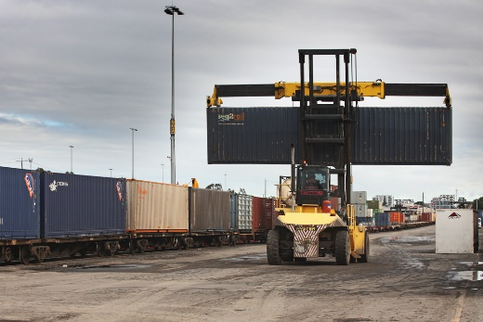
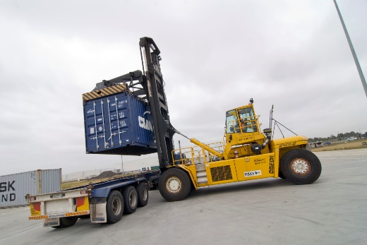
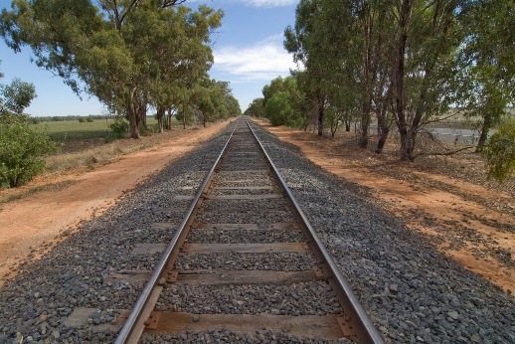
ACTION
Reserve land and transport connections for Victoria’s new interstate freight terminals – the WIFT at Truganina and the BIFT at Beveridge, Include these land reservations in the PFN. Prepare a business case for and develop WIFT.
ACTION
Recognise the existing and planned regional intermodal terminals in the Principle Freight Network. With local councils, review existing, and identify and reserve sites for new freight terminals and precincts.
ACTION
Develop and publish an Asset Management Plan for the regional freight network which will form the basis of an annual major maintenance program for the network. Include an allowance for achieving the required ‘future state’ for the rail network by 2050.

Slide 10
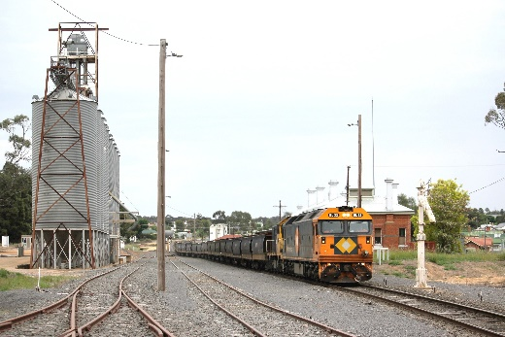
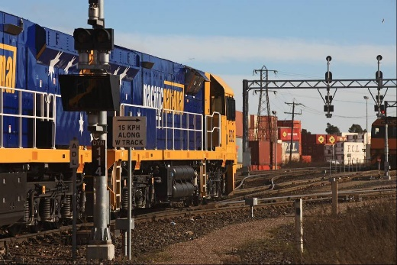

ACTION
Review current freight rail operations and infrastructure to identify opportunities for improving the efficiency of the network for operators, and ultimately for primary producers and other users.
Implement a series of short-term improvements arising from the review.
ACTION
Complete a study of the costs and benefits of standardising further corridors on the regional rail network.
ACTION
Advocate to the Commonwealth to invest in freight rail infrastructure in Victoria, starting with the Portland-Maroona line.

Slide 11

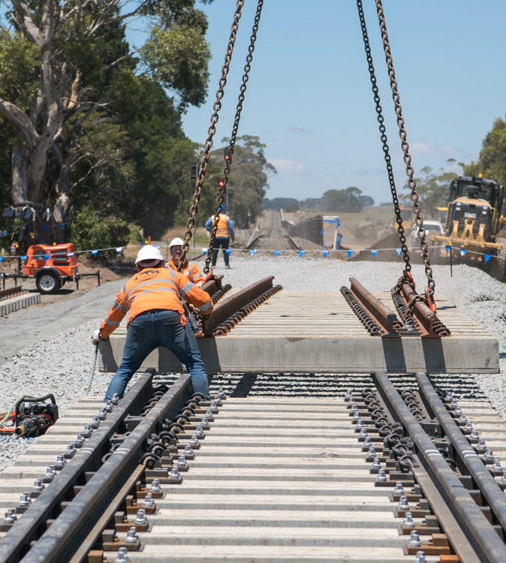
What we’re doing now
Regional Rail Revival
Murray Basin Rail Project
Shepparton Freight Rail Network Planning
Mode Shift Incentive Scheme
Inland Rail
Western Intermodal Freight Terminal
Port Rail Shuttle Network

Slide 12
Murray Basin Rail Project
Concrete sleepers | 265,000
Timber sleepers | 175,000
New rail | 3400 metres
Level crossings assessed | 100 +
Rail standardisation work completed | 406 kilometres
Rail line reopened | 87 kilometres
Additional freight carried by each grain train | 300 tonnes
Improvement in bulk rail freight transport efficiency | 16 per cent
Jobs generated | 500
Benefit to local economy | $15.8 million

Slide 13

Yelta
Merbein
Manangatang
Works under way
Mildura
Carwarp
Sea Lake
Ultima
Murrayville
Ouyen
Nullawil
Broad-gauge freight only
Broad-gauge passenger and freight
V/Line standard gauge
ARTC standard gauge
Dual gauge
Grain terminal
Intermodal terminal
Underbool
Quambatook
Speed
Wycheproof
Woomelang
Charlton
Hopetoun
Birchip
Boort
Rainbow
Korong Vale
$23 million in maintenance works will boost speeds on the Manangatang line to 65kmh
Beulah
Donald
Nhill
Jeparit
Dooen
Dunolly
Warracknabeal
Lillimur
Dimboola
Maryborough
Murtoa
Ararat
Ballarat
Warrenheip
New rail junction will give trains from the Maryborough-Ararat line access to the ARTC network
Maroona
Westmere
Berrybank
Works to automate C-Box will give trains from the north-west lines unrestricted access to the Port of Geelong
Gheringhap
North Geelong
C-Box
Port of Geelong
Port of Portland

Slide 14
Regional Rail Revival
1 | Ballarat Line Upgrade
2 | Bendigo and Echuca Line Upgrade
3 | Geelong Line Upgrade (including the Armstrong Creek reservation)
4 | Gippsland Line Upgrade Stage 1
5 | Gippsland Line Upgrade Stage 2 (Avon River Bridge)
6 | North East Corridor Upgrade
7 | Shepparton Freight Network Planning
8 | Shepparton Line Upgrade (Stages 1 and 2)
9 | Warrnambool Line Upgrade
SWAN HILL
ECHUCA
7
ALBURY
2
SHEPPARTON
6
BENDIGO
2
8
MARYBOROUGH
SEYMOUR
ARARAT
BALLARAT
1
3
WARRAGUL
5
BAIRNSDALE
4
SALE
9
GEELONG
TRARALGON
WARRNAMBOOL

Slide 15
Regional Rail Revival
1 | Ballarat Line Upgrade
2 | Bendigo and Echuca Line Upgrade
3 | Geelong Line Upgrade (including the Armstrong Creek reservation)
4 | Gippsland Line Upgrade Stage 1
5 | Gippsland Line Upgrade Stage 2 (Avon River Bridge)
6 | North East Corridor Upgrade
7 | Shepparton Freight Network Planning
8 | Shepparton Line Upgrade (Stages 1 and 2)
9 | Warrnambool Line Upgrade
SWAN HILL
ECHUCA
7
ALBURY
2
SHEPPARTON
6
BENDIGO
2
8
MARYBOROUGH
SEYMOUR
ARARAT
BALLARAT
1
3
WARRAGUL
5
BAIRNSDALE
4
SALE
9
GEELONG
TRARALGON
WARRNAMBOOL

Slide 16
Regional Rail Revival
1 | Ballarat Line Upgrade
2 | Bendigo and Echuca Line Upgrade
3 | Geelong Line Upgrade (including the Armstrong Creek reservation)
4 | Gippsland Line Upgrade Stage 1
5 | Gippsland Line Upgrade Stage 2 (Avon River Bridge)
6 | North East Corridor Upgrade
7 | Shepparton Freight Network Planning
8 | Shepparton Line Upgrade (Stages 1 and 2)
9 | Warrnambool Line Upgrade
SWAN HILL
ECHUCA
7
ALBURY
2
SHEPPARTON
6
BENDIGO
2
8
MARYBOROUGH
SEYMOUR
ARARAT
BALLARAT
1
3
WARRAGUL
5
BAIRNSDALE
4
SALE
9
GEELONG
TRARALGON
WARRNAMBOOL

Slide 17
Inland Rail and the WIFT
Existing rail network
Inland Rail route
Constraint on double stacking - Bunbury St tunnel
WIFT
TOTTENHAM
DYNON

Slide 18
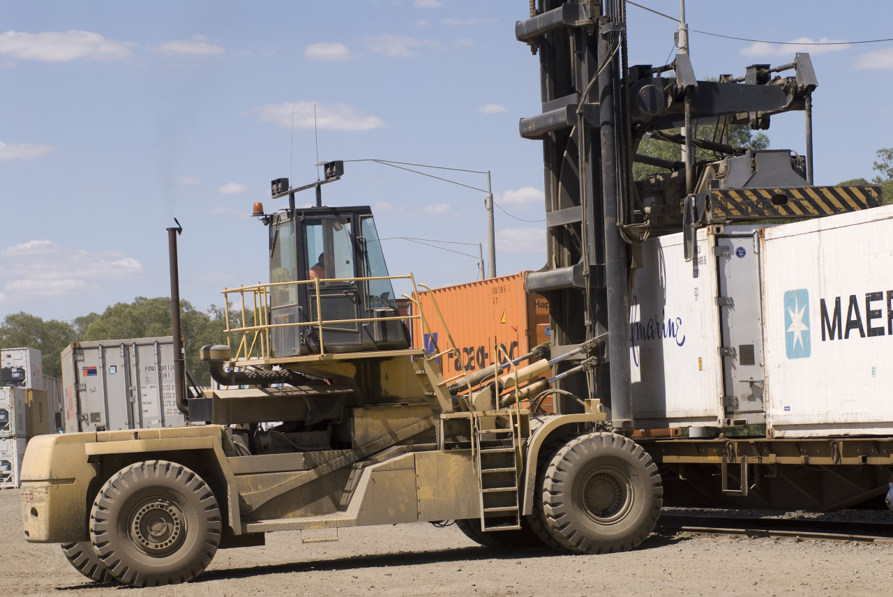
Mode Shift Incentive Scheme
$4 million in the 2019-20 financial year to encourage more containerised freight on rail
Incentives in place for customers of terminals at Merbein, Dooen, Tocumwal and Dennington

Slide 19
SOMERTON
BEVERIDGE
$9.5 million to better connect Altona terminal to the network
$16.2 million to better connect Somerton terminal to the network
TRUGANINA
DYNON
ALTONA
Port Rail Shuttle
On-dock rail at Swanson Dock
Existing intermodal terminal
Proposed interstate freight terminal
Potential connection
LYNDHURST

Slide 20
A rail freight success story
Containerised cement from Dynon to Dandenong South
Road leg from Waurn Ponds to Dynon
Transfer of containers from road to rail at Dynon
DYNON
Rail leg from Dynon to Dandenong South
WAURN PONDS
Clinker transferred to Waurn Ponds where it is used to make cement and containerised
Clinker arrives from China and is unloaded at Lascelles Wharf, Port of Geelong
DANDENONG SOUTH

Slide 21
Yelta
Merbein
Manangatang
Mildura
Broad-gauge freight only
Broad-gauge passenger and freight
V/Line standard gauge
ARTC standard gauge
Dual gauge
Grain terminal
Intermodal terminal
Carwarp
Sea Lake
Ultima
Murrayville
Ouyen
Nullawil
Underbool
Quambatook
Speed
Wycheproof
Woomelang
Charlton
Hopetoun
Birchip
Boort
Rainbow
Korong Vale
Beulah
Donald
Jeparit
Nhill
Dooen
Dunolly
Warracknabeal
Lillimur
Dimboola
Maryborough
Murtoa
Ararat
Ballarat
Warrenheip
Maroona
Westmere
Berrybank
Gheringhap
Dynon
A rail freight success story
Containerised hay from Ultima to Victoria Dock
Victoria Dock
North Geelong
Port of Geelong

Slide 22

Andrew Newman
Director Freight, Ports and Intermodal
Freight Victoria

