Slide 1
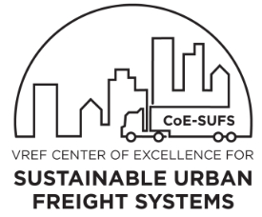
Hyperconnected City Logistics
Assoc. Prof. Russell G. Thompson
Department of Infrastructure Engineering
Melbourne School of Engineering
rgthom@unimelb.edu.au
Rail Futures Conference, 27th June 2018

Slide 2
Outline
Introduction
City Logistics
Physical Internet
Hyperconnected City Logistics
Synchromodality
Social Cost Benefit Analysis

Slide 3
Urban Freight Challenges
Growth Development
Congestion (road & rail)
Disruption (incl. construction, METRO, extreme weather, special events, incidents)
Levels of Service: eCommerce (esp. B2C)
Decarbonised Logistics
Threatening efficiency, reliability & sustainability
Notes:
3

Slide 4
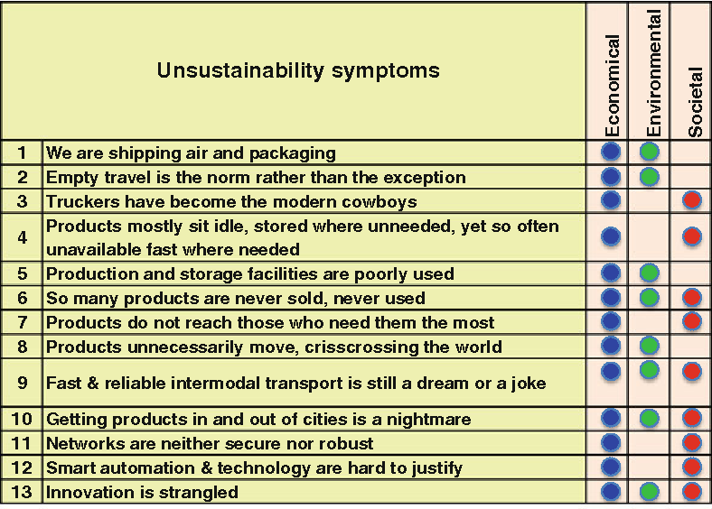
Montreuil and Ballot

Slide 5

City Logistics is an integrated approach for urban goods distribution based on the systems approach. It promotes innovative schemes that reduce the total cost (including economic, social and environmental) of goods movement within cities
OECD, (2003) Delivering the Goods,
Challenges for the 21st Century, Paris.
Major recommendations
Consolidation key to achieving sustainable urban
goods transport
Technological & conceptual innovation can support
sustainable urban goods transport

Slide 6
Structure of visions for city logistics

Slide 7
Administrators
Shippers
Residents
Carriers
Receivers
Key Stakeholders in City Logistics

Slide 8
Physical Internet (PI)
Aims to transform the way physical objects are moved, stored, realized, supplied & used, pursuing global logistics efficiency & sustainability
Key Elements
Open & Shared Networks
Standardised & modular load carriers
Track & Trace protocols & certificates
New business models for sharing assets

Slide 9
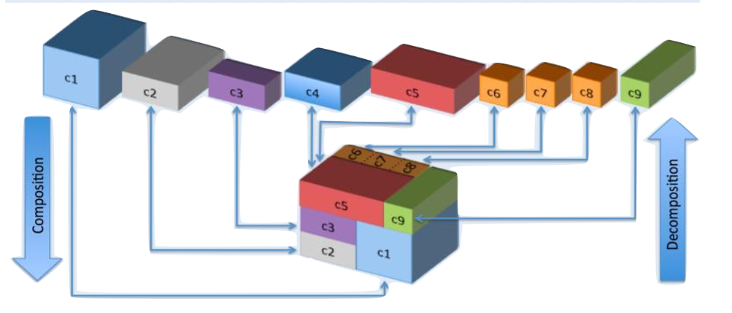
Physical Internet Themes
Corridors, hubs & synchromodality
City Logistics
Sustainable & safe supply chains
Supply network coordination (4C)
Information Technology
PI containers

Slide 10
PI Features
Compatible load units & coordinated transfers between modes
From: Right mode for the right load
To: Right modes & load factors for the right loads
Multiple modes: eg. EVs, bikes, trolleys
Network Design: vehicles, loads & transhipment facilities
Multi-modal routing & scheduling
Integration: vehicles: loading bays/docks, drivers: walking
Notes:
10

Slide 11
PI Concepts
Involves fully coordinated & integrated logistics system to improve sustainability
Main physical elements are containers, nodes & movers
Goal: “enable the global sustainability of physical object movement, handling, storage, realization, supply & usage” (Montreuil, 2010)
Hyperconnected City Logistics (HCL) combines concepts of City Logistics & PI (Crainic & Montreuil, 2016)

Slide 12
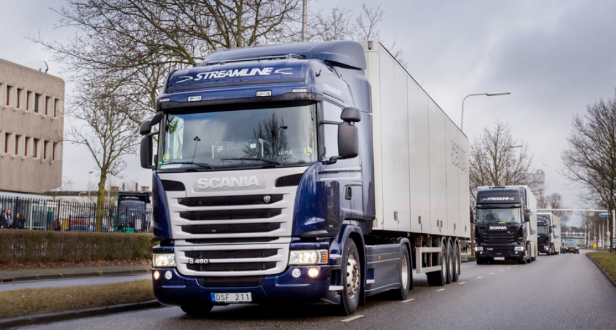
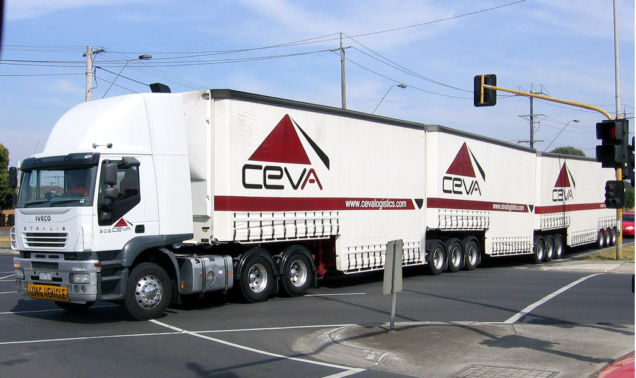
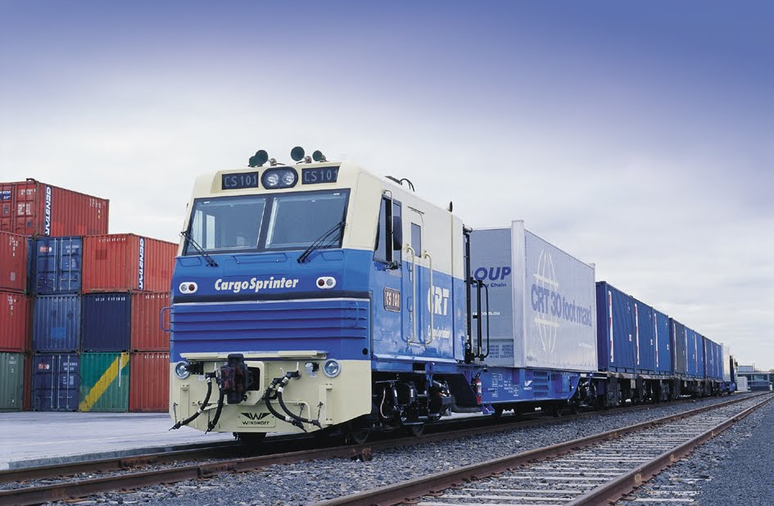
Movers
Need to determine best vehicles to transport goods between nodes - influences LOS, efficiency & productivity
Promising Local Initiatives
Truck Platooning
  High Productivity Vehicles (HPVs)
Urban Rail Shuttles

Slide 13
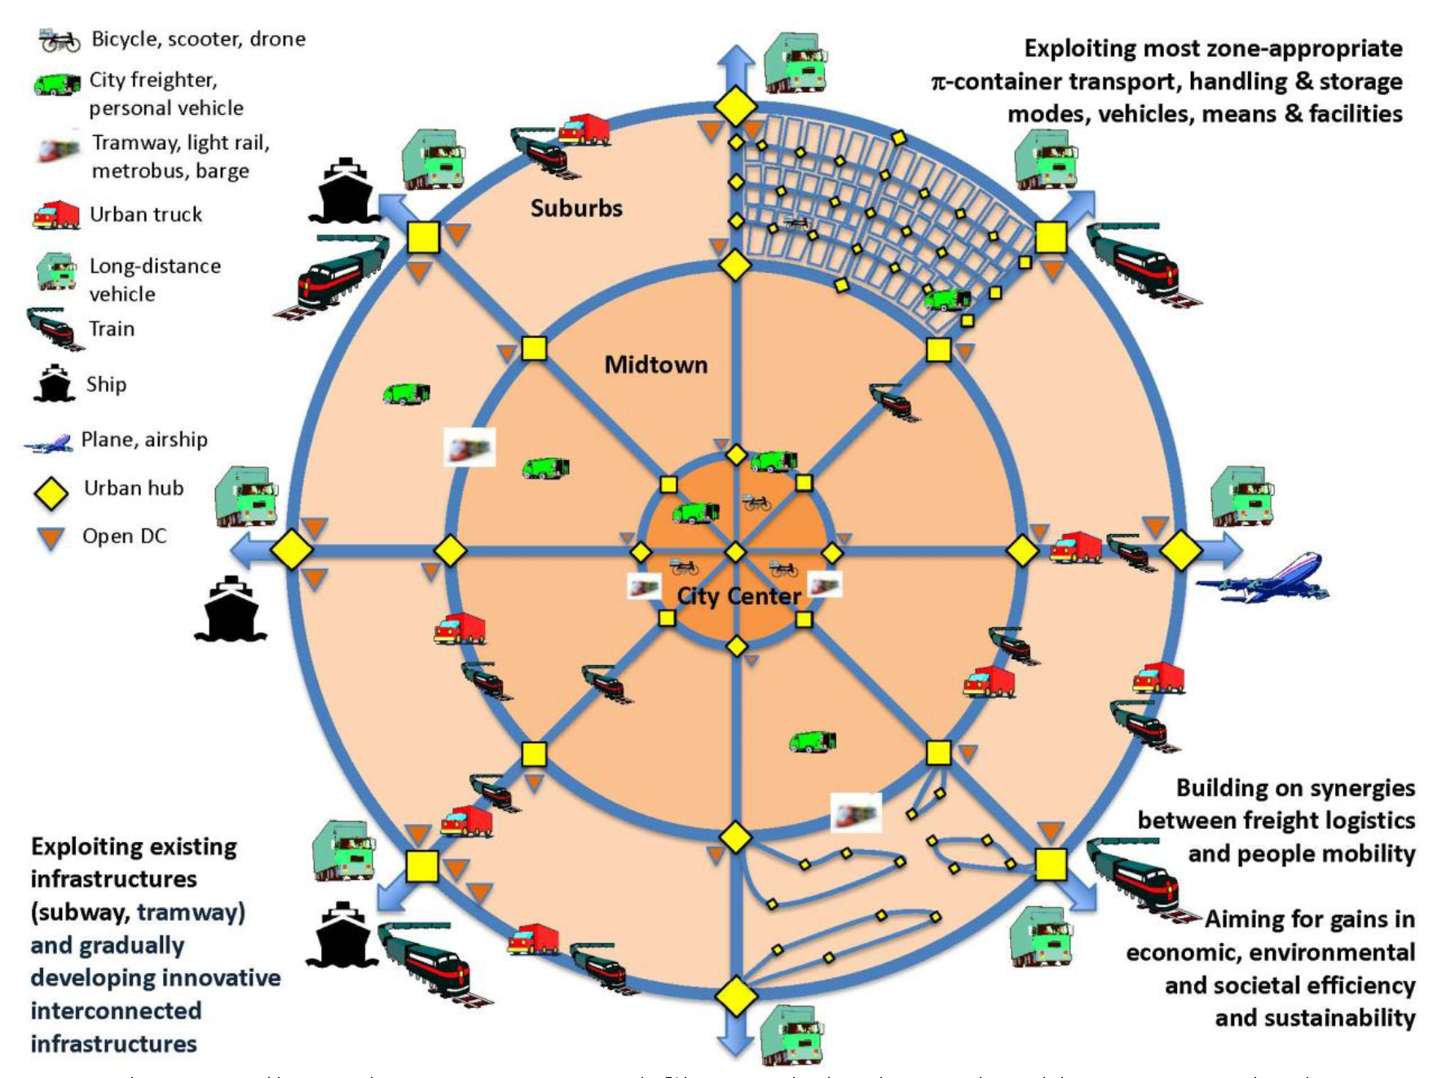
Hyperconnected City Logistics
Cranic and Montreuil (2016)

Slide 14
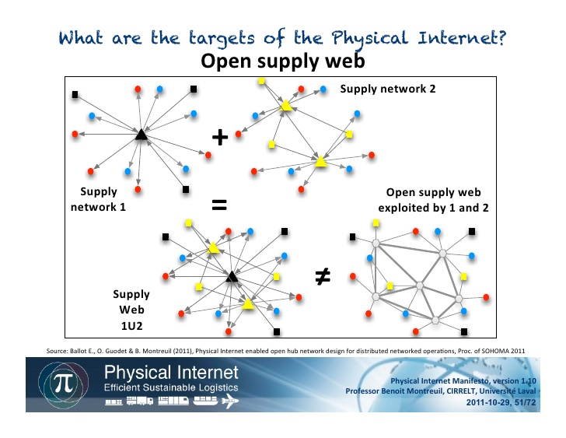

Slide 15
Case Study
In Melbourne
Customers
Suppliers
Exchange
Supplier
Distance with no collaboration (km) | 2899.5
Distance with collaboration (km) | 640.8
Reduction (km) | 2258.7
Reduction (%) | 77.9

Slide 16
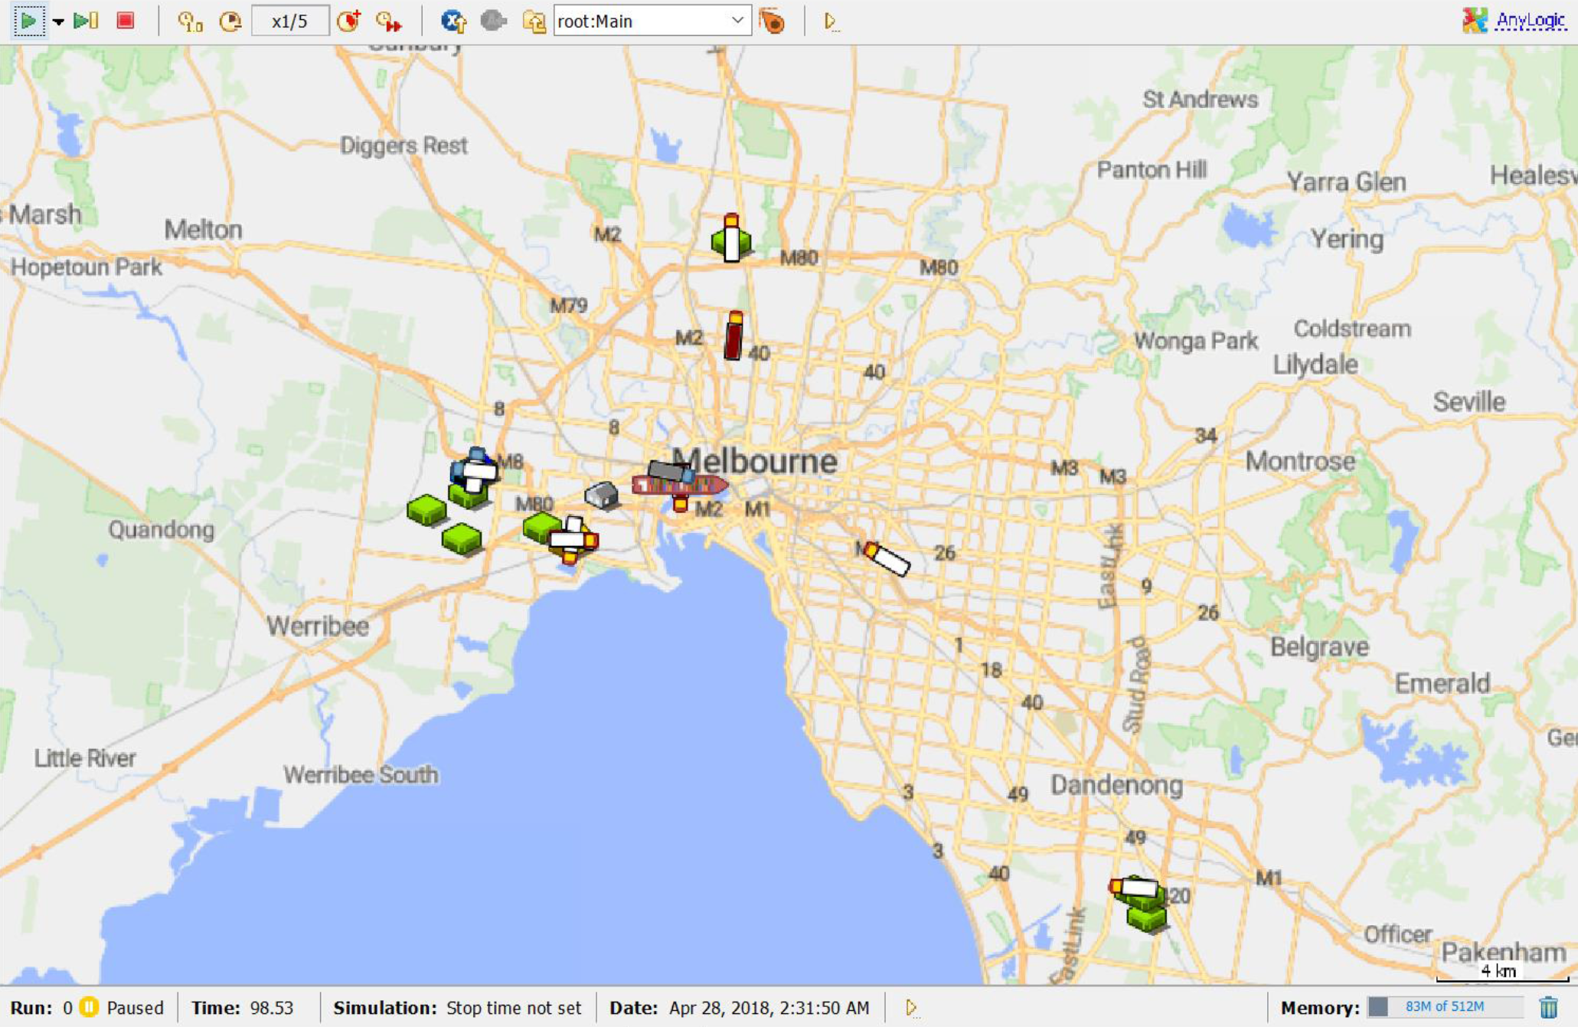
Empty Container Simulation

Slide 17
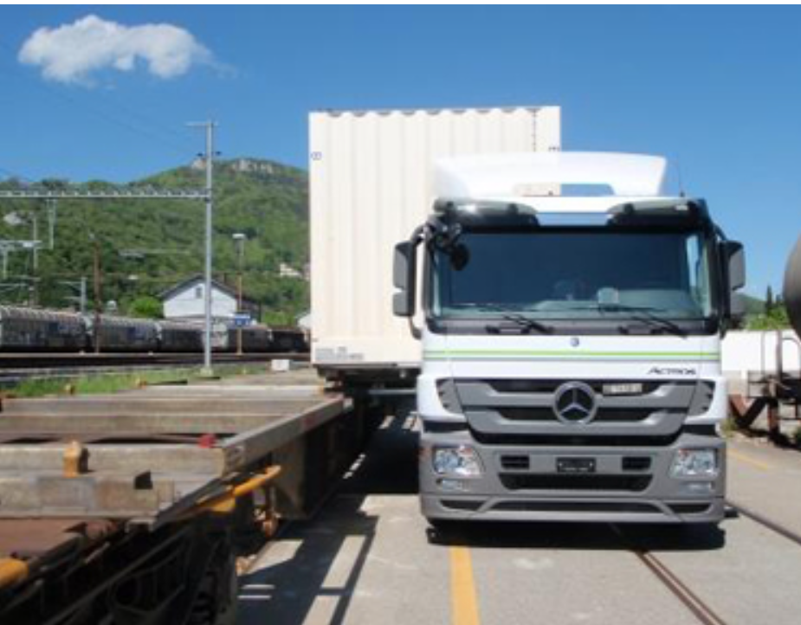
Fast Transhipment
Inovatrain

Slide 18
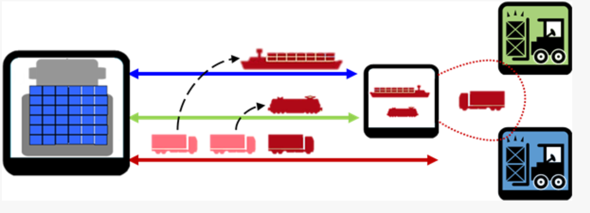
Synchromodality
Synchromodality is the optimally flexible and sustainable allocation of cargo to different modes and routes in a network under the direction of a logistics service provider, so that the customer (shipper or forwarder) is offered an integrated solution for its (inland) transport.
TU Delft

Slide 19
Synchromodal Concepts
Aim: Increase utilisation rates
Systemic thinking
Focus on available capacity
Regardless of mode of transport
Exchanging information

Slide 20
Social Cost Benefit Analysis (SCBA)
Monetising negative externalities such as noise & emissions
Based on welfare maximization, where all effects, including negative externalities, are monetised
Distinction made between direct, indirect & external effects
Allows effects to be compared with each other
Notes:
20

Slide 21
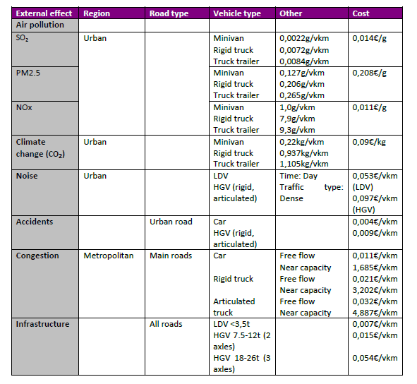
Kin and Macharis (2015)

Slide 22
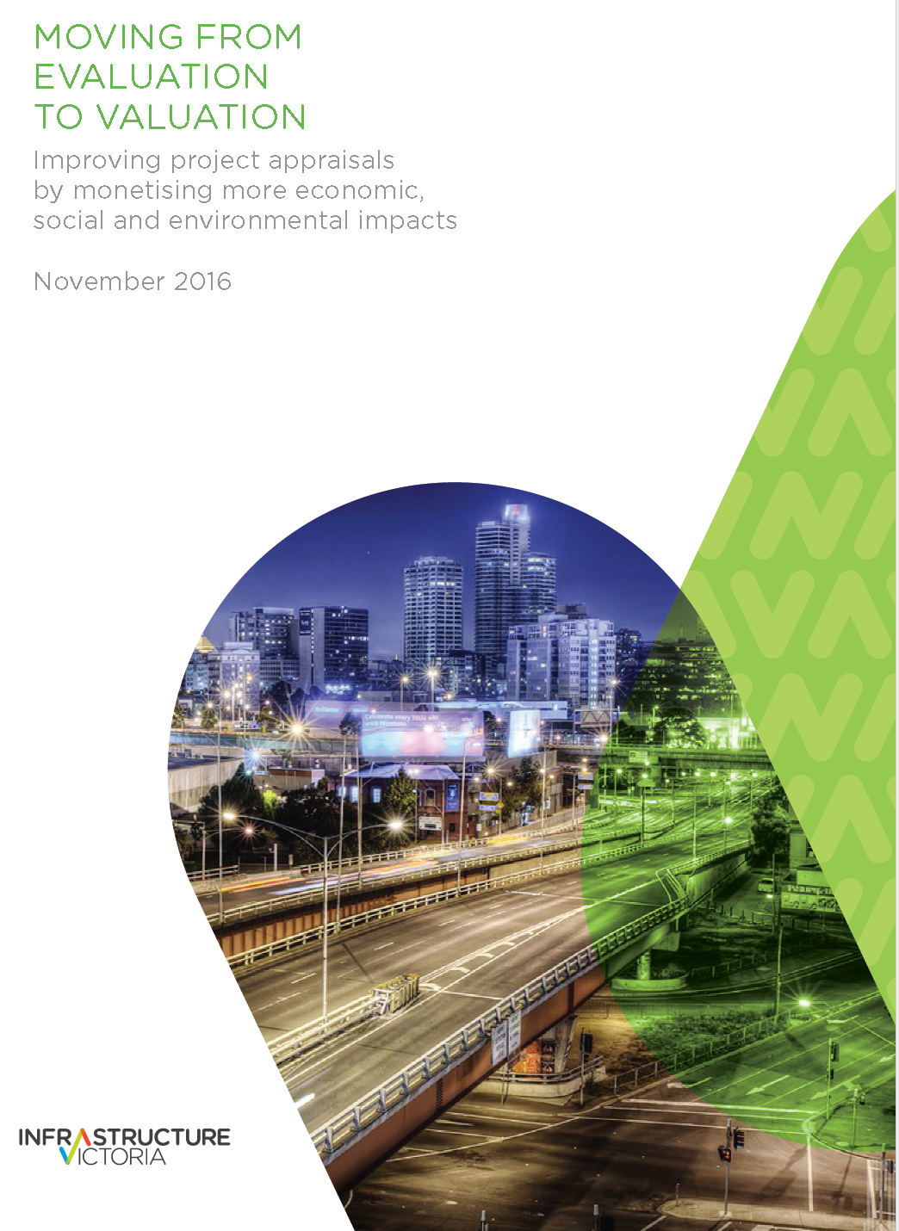

Slide 23



